Slide 1

EBS

Slide 2
BLOCK STORAGE TYPES
EBS :
* Persistence : if you stop/reboot then data will not be deleted.
* If you terminate then it will be deleted.
* N/w Attached Virtual Drive.
* N/w Attached is slow than physical attached.
2. INSTANCE STORE BACKED EC2 :
* The virtual Hard Drive on the host is allocated to EC2 Instances.
* It is limited to some instances.
* Non-Persistence : if you stop/reboot then data will be deleted.

Slide 3
What is EBS :
* It is a external block storage that you can attach to EC2
* ES is a Network attached virtual Hard drive.
* Multiple EBS volumes can be attached to a single EC2.
* We can Attach a multiple Volume to EC2 once at a time.
* Up to 16 instances to share a single EBS volume.
* EBS Volumes and instances must be in same AZ.
* We can Copy EBS to multiple Regions to prevent Data loss.

Slide 4
ADVANTAGES :
Scalability
Backup
Encryption
Multi-Attache

Slide 5
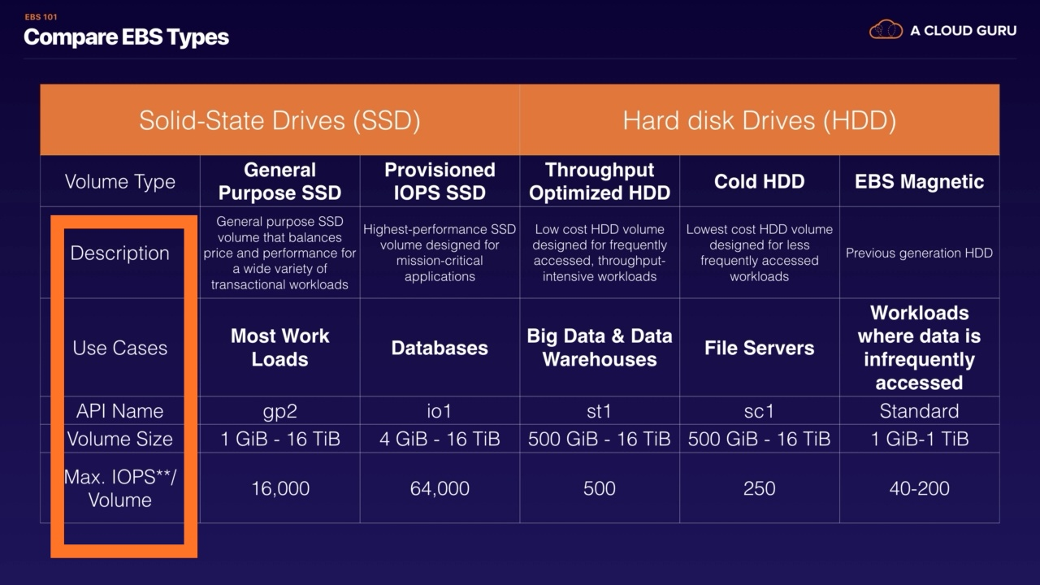
TYPES :

Slide 6
What is SnapShot :
EBS Snapshots are copies of your EBS Volumes.
WE can create up to 5000 EBS Volumes in a single account.
We can create up to 10000 EBS snapshots in a single account.
Snapshots can be stored on S3 (not ours) but can only be accessed through EC2 API’S.
Snapshots will be Region Specific.
While taking snapshot we need to stop server.
If Data is added to server while taking snapshot it wont be written.
Once snapshot is created Copy it to other region.
We can restore snapshot even if we delete them.
We can store snapshots in Archive for saving up to 75%.

Slide 7
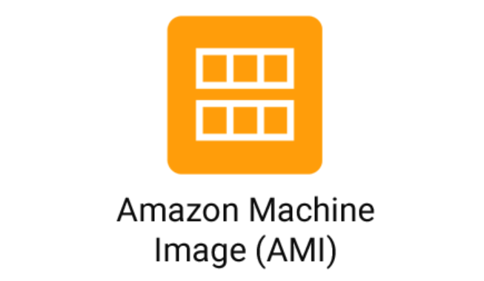

Slide 8
OS ROOT DEVICE STORAGE SOFTWARE
PACKAGES

Slide 9
AMI :
An Amazon machine Image (AMI) is an Template that provides the software that is required to set up and boot an Amazon EC2 instance.
Each AMI also contains block device.
You must specify an AMI when you launch an instance.
The AMI must be compatible with the instance type.
We can create our own AMI or use Public AMI.
We can sell our AMI on AWS Market Place.

Slide 10
PROCESS :
DEPLOY APP TO SERVER
DELECT SERVER → ACTION → IMAGES & TEMPLATES → CREATE IMAGE
NAME : ABC → CREATE IMAGE
AMI → SELECT IMAGE → LAUNCH INSTANCE FROM AMI
LOGIN TO SERVER AND START HTTPD

